Slide 1
IP Wireless Access in Vehicular Environments (IPWAVE) Basic Protocols Project
IETF 109 Hackathon, Online
Champion: Jaehoon Paul Jeong
Students: Yiwen (Chris) Shen, (SKKU)
Bien Aime Mugabarigira, (SKKU)
Xiaohong (Dawn) Yu, (SKKU)
Jae Won Lee, (SKKU)
Kyoungjae Sun (SSU),
Jinho Park (KNU)
November 9-14, 2020
On-Off Mix

Slide 2



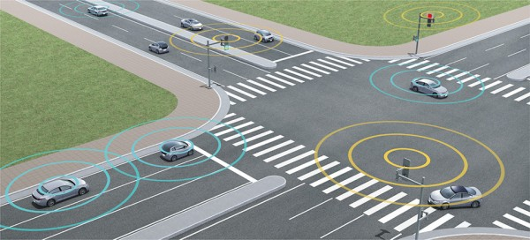
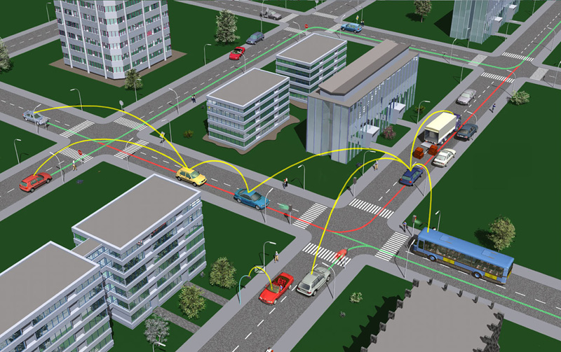
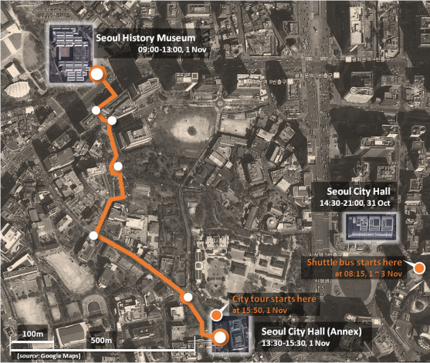
Use Cases of Vehicular Networking
Vehicle Traffic Release
City Road Emergency
Road Intersection Passing
Navigation
Connected Automated Vehicles
Vehicle Data Forwarding Services

Slide 3
Hackathon Plan
Implement the enhanced IPv6 ND in a Linux Kernel to enable the proposed new ND options for vehicle driving safety.
Testing the modified Linux Kernel with a robot car to verify the CNP for crash avoidance.

Slide 4
Context-Aware Navigator Protocol over IPWAVE
CCM
ECM
Road-Context Awareness through Light-weight Message Exchange
- Cooperation Context Message (CCM) and Emergency Context Message (ECM)
Reference: “Context-Aware Navigator for Road Safety in Vehicular Cyber-Physical Systems”, The Third International Conference On Consumer Electronics (ICCE) Asia, June 2018.
http://iotlab.skku.edu/publications/international-conference/ICCE-ASIA-CAN.pdf

Slide 5
Vehicle Mobility Information (VMI)
VMI Option as an ND Option:
Type: CCM or ECM
0
1
2
3
0
1
2
3
4
5
6
7
8
9
0
1
2
3
4
5
6
7
8
9
0
1
2
3
4
5
6
7
8
9
0
1
Type | Length | Message | Reserved 1
Reserved 2
Mobility Information

Slide 6
Previous Work
IPv6 Packet Transmission over two OCB-enabled WiFi modules in vehicular networks
How to enable a commercial WiFi module to work on 5.9GHz band?
How would IPv6 ND work in IEEE OCB mode?
How to enable webcam (dashcam) streaming by IPv6 over 802.11 OCB mode?
Context-Aware Navigation Protocol Simulation
How can we use IPWAVE protocol for road crash avoidance?
Related IPWAVE standard Drafts:
https://datatracker.ietf.org/doc/draft-ietf-ipwave-ipv6-over-80211ocb/
https://datatracker.ietf.org/doc/draft-ietf-ipwave-vehicular-networking/

Slide 7
What got done
Compiling Linux Kernel for OCB mode (Kernel version 4.4).
Modify Makefile to remove possible errors
Menuconfig for OCB mode
Enable ITS G5/DSRC band
Atheros 802.11 ath9k wireless card driver
Enable webcam driver
IPv6 packet transmission by two OCB-enabled WiFi modules.
IPv6 address configuration
UDP packets transmission
Webcam streaming
Implementation of VMI as ND Option in Linux Kernel

Slide 8
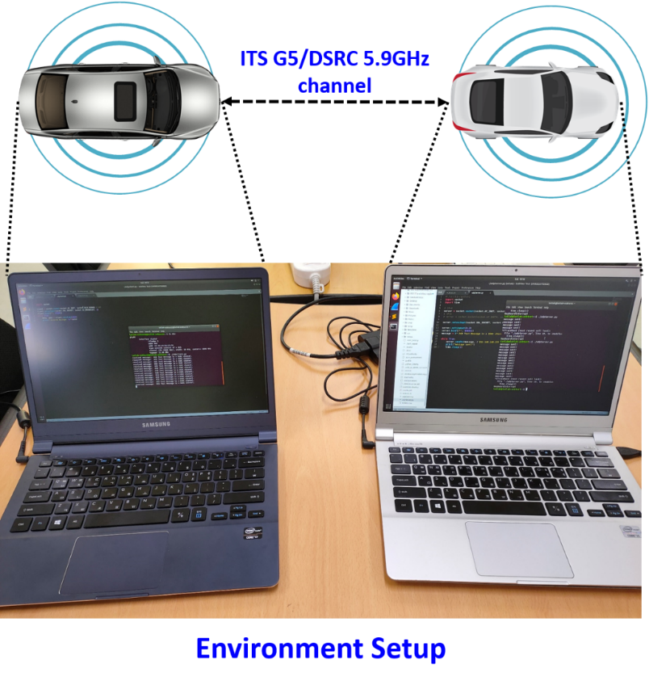
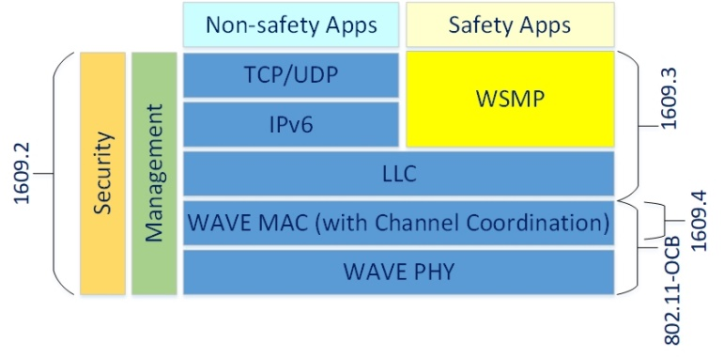
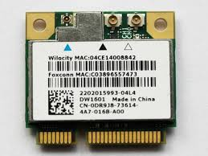
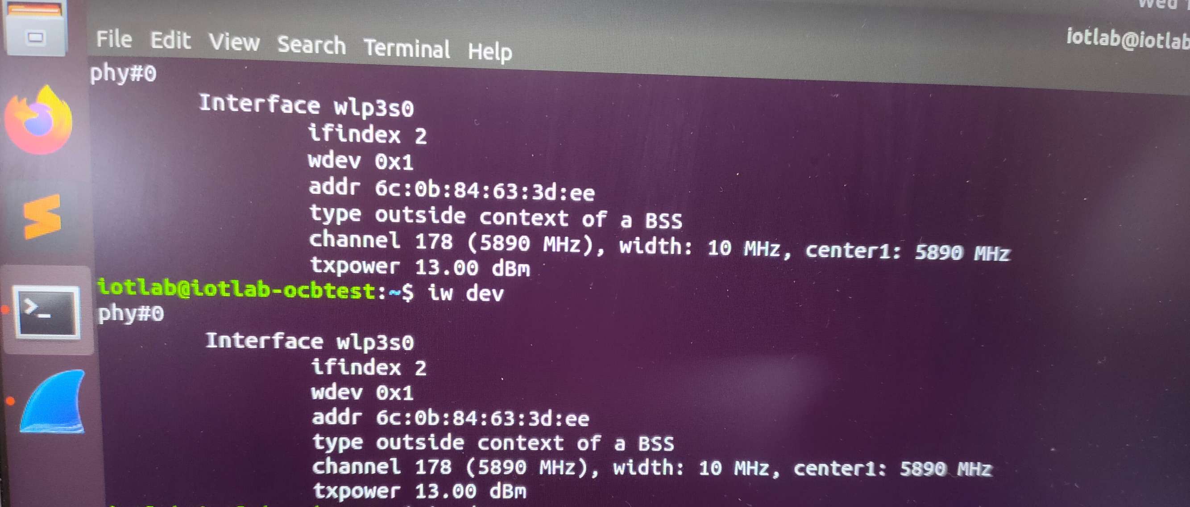
Setup Environment

Slide 9
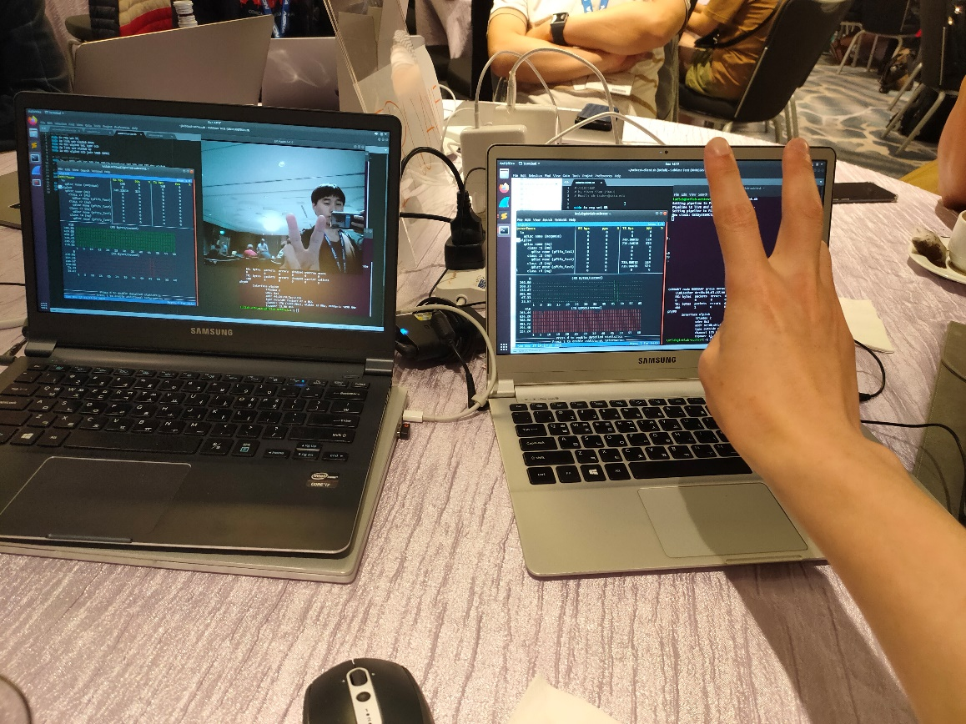
Experiment
Successfully stream webcam over two OCB-enabled laptops.

Slide 10
What We Learned
Compiling error can happen due to Makefile setting.
Updated Makefile to remove the error
Updated Makefile of Central Regulatory Domain Agent (CRDA) to remove a compiling flag, -Werror, that shows compiling errors when variables are not used.
Made a new manual for running OCB mode
IPv6 ND is not automatically running on the interface.
No Carrier shown on the interface
Need to manually configure IPv6 address and neighbors

Slide 11
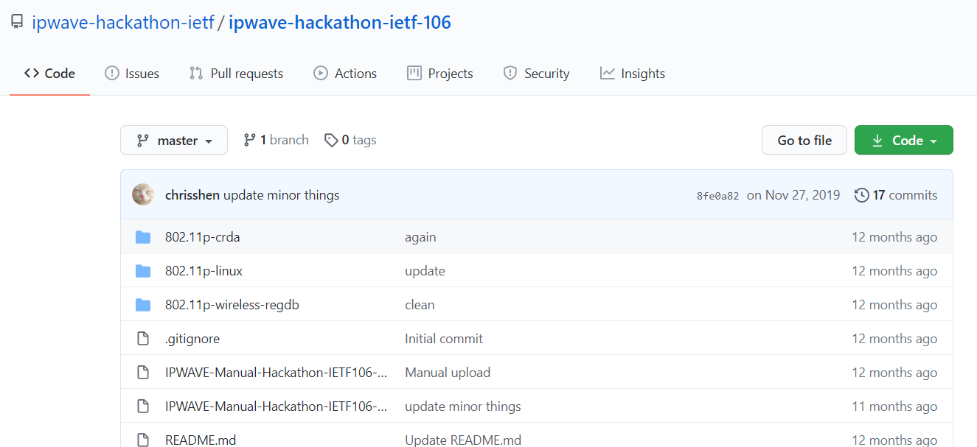
Open Source Project at Github https://github.com/ipwave-hackathon-ietf/ipwave-hackathon-ietf-106

Slide 12
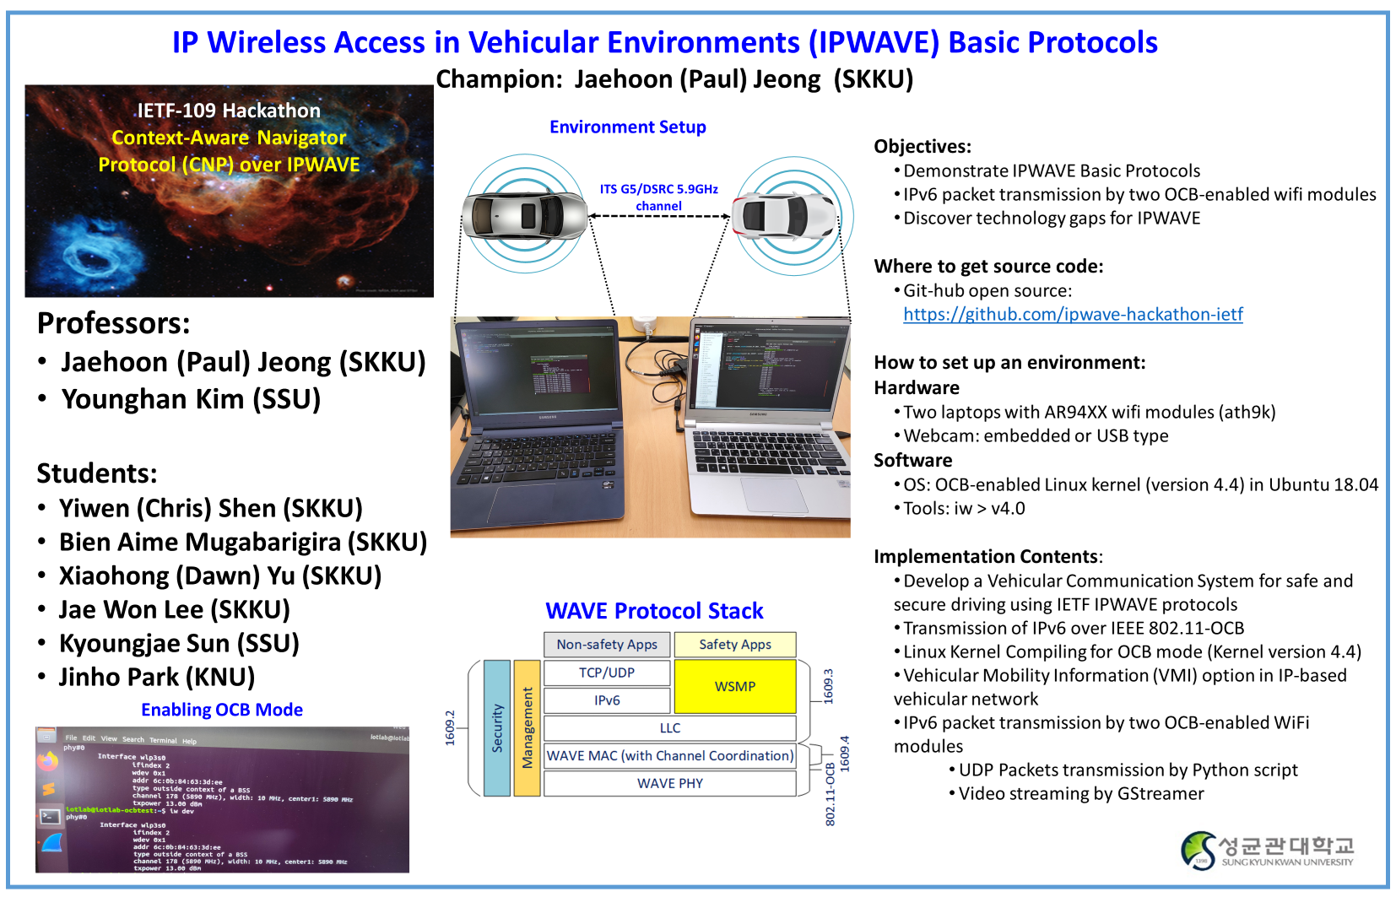

Slide 13
Wrap Up
Team members:
Champions:
Jaehoon Paul Jeong (SKKU)
Professors:
Jaehoon Paul Jeong (SKKU)
Yonghan Kim (SSU)
Students:
Yiwen Chris Shen (SKKU)
Bien Aime Mugabarigira (SKKU)
Xiaohong (Dawn) Yu (SKKU)
Jaewon Lee (SKKU)
Kyoungjae Sun (SSU)
Jinho Park (KNU)
Video clip demo: https://youtu.be/gQxOLU740b4
https://www.youtube.com/watch?v=6Ss5OzV88so
Where to get code (manual):
https://github.com/ipwave-hackathon-ietf/ipwave-hackathon-ietf-106
Original contributors:
Czech Technical University and Volkswagen:
https://ctu-iig.github.io/802.11p-linux/

